Slide 1
Chapter 6 Searching and Sorting

Slide 2

Searching Algorithms
6.1
Using lists or arrays to store data helps us organise large amounts of related data. To find a record in the list that is the same as the target value, we need to perform a search.
Whether the items in the list are sorted will also affect the design and efficiency of the algorithm. This chapter will discuss the design and efficiency of different search algorithms.

Slide 3
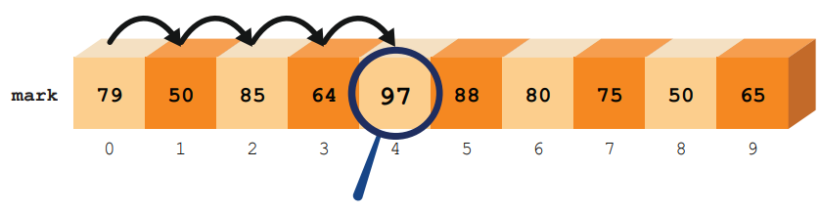
Linear search
A
The easiest way to know if the target value exists in the list is to search the list from the beginning, i.e. start from index 0, then go through index 1, index 2 and so on until you reach the last index in the list or find the target value.
This algorithm is called linear search. It is often used to search unsorted lists.

Slide 4
Linear search
A
Suppose unsorted list mark stores the test scores of ten students, as listed below:
The following Python program can search whether the target score exists in the list (ifexist).
target = int(input()) found = False for i in range(0, len(mark)): if target == mark[i]: found = True print(found)

Slide 5
Linear search
A
If the target value entered exists in the list, e.g. “50”, the final output of the program will be True;
If the target value entered does not exist in the list, e.g. “100”, the final output of the program will be False instead.

Slide 6
Linear search
A
Since we only need to know if the target value exists in the list, we can use the while loop with an additional condition so that the program will stop the loop once it finds the same value as the target value, increasing the efficiency of the search algorithm.
target = int(input()) found = False i = 0 while i < len(mark) and found == False: if target == mark[i]: found = True i = i + 1 print(found)

Slide 7
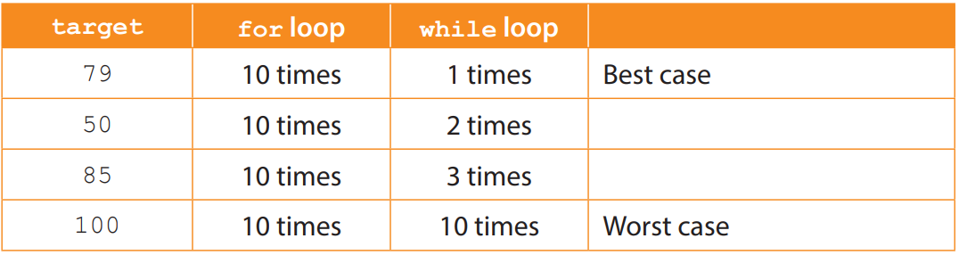
Linear search
A
Using the following sample data, analyse how many evaluations are required for each of the two algorithms (target == mark[i]):
As you can see, it is more efficient to use a while loop, since it leaves the loop as soon as it finds the target value, without proceeding to check all items in the list.

Slide 8
Linear search
A
We can now rewrite the program so that when the target value is found, the program will output its index in the list.
target = int(input()) index = -1 for i in range(0, len(mark)): if target == mark[i]: index = I print(i) if index == -1: print("No result is found.")

Slide 9
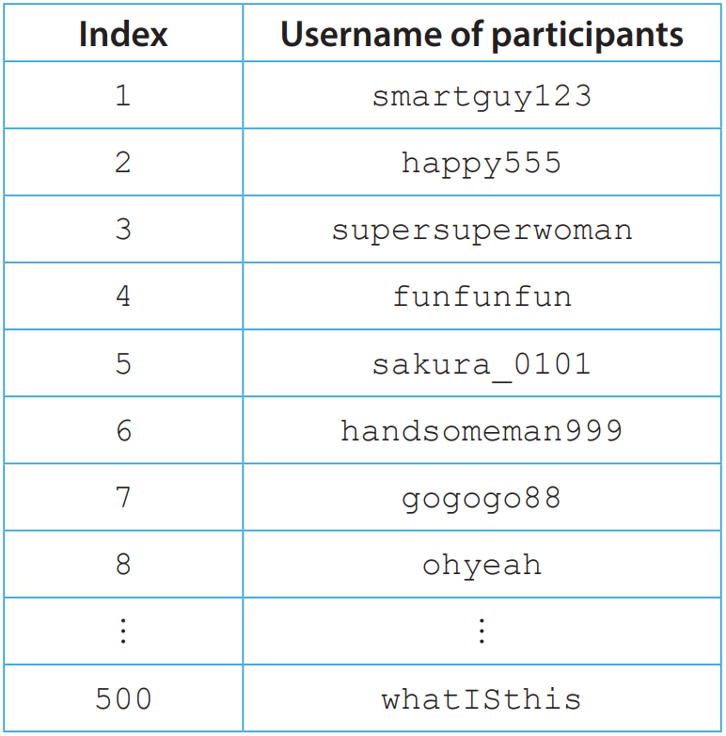
6.1
1. The following array participant stores the username of participants who have signed up for a webinar:

Slide 10
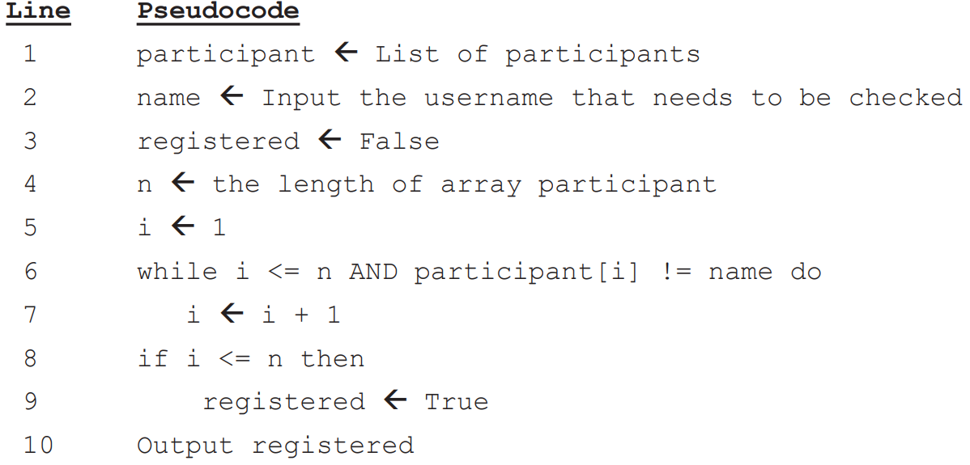
6.1
Matthew uses the following linear search algorithm to check if the username entered is registered for the webinar.

Slide 11
6.1
(a) Write down the number of times the program needs to make the evaluation “participant[i] ! = name” for each of the names entered below.
(i) Enter “smartguy123”
(ii) Enter “funfunfun”
(iii) Enter a name that is not recorded
(b) Assuming that the username entered can be found in this array, what is the program’s average number of searches?

Slide 12
6.1
◣ Solution
(a) (i) 1
(ii) 4
(iii) 500
(b) 250

Slide 13
6.1
Complete Checkpoint 6.1 on P. 214 of the textbook.
(a) found == -1
(b) (i) The search method remains unchanged, and the average number of searches needed to find the target value is still 25 (n/2).
(ii) and staff_no >= retire[i] When searching through a list that has been sorted in ascending order, as soon as an item in the list is found to be larger than the target value, it can be established that the remaining items in the list are also larger than the target value (i.e., not equal), thus the loop can stop immediately.

Slide 14
Binary search
B
As you can see from unsorted list mark above, the worst case that a program using linear search can encounter is when the search continues to the last index of the list.
The efficiency of linear search is rather low for searching lists with many items.

Slide 15
Binary search
B
In this section, we will introduce another commonly used search algorithm — binary search.
It can be performed on sorted lists only.

Slide 16
Binary search
B
The following list mark stores the test scores of ten students and has been sorted in ascending order. It happens that the score of each student is different:

Slide 17
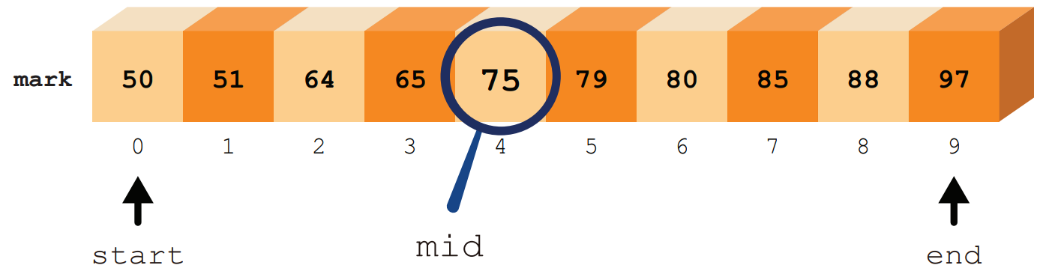
Binary search
B
Suppose that the target value is “80”: 1. In a binary search, the item in the middle of the list will be compared first. If it is the same as the target value, the search ends.

Slide 18
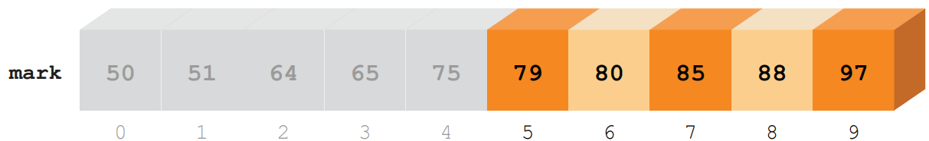
Binary search
B
2. If the item is different from the target value, the program will continue searching. Since the list is sorted, if the item is smaller than the target value, the target value can only appear in the second half of the list.

Slide 19
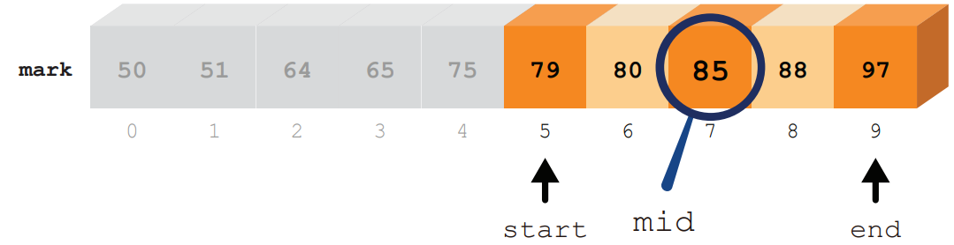
Binary search
B
3. Narrow the search to the second half of the list and compare the item in the middle.

Slide 20
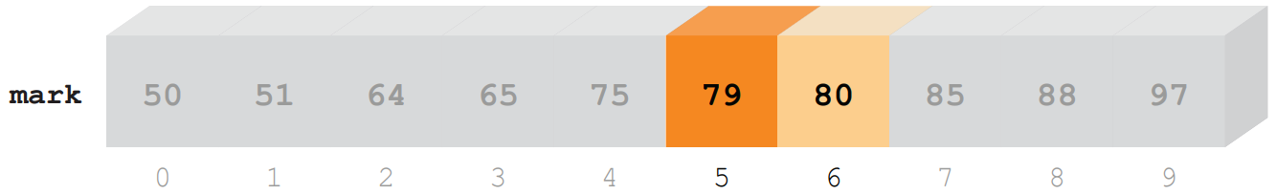
Binary search
B
4. Since the item is larger than the target value, it means that the target value can only appear in the first half of the search range.

Slide 21
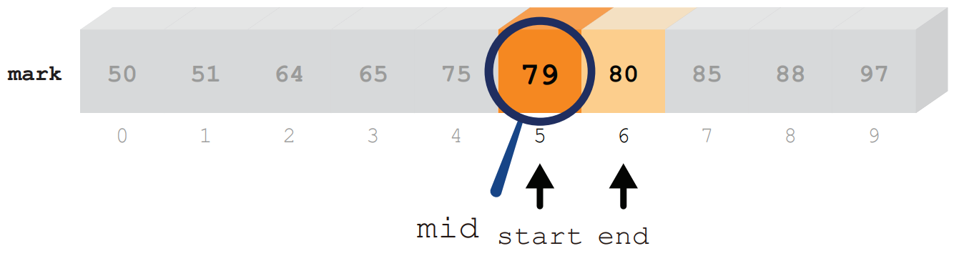
Binary search
B
5. Narrow the search range again and compare the item in the middle.

Slide 22
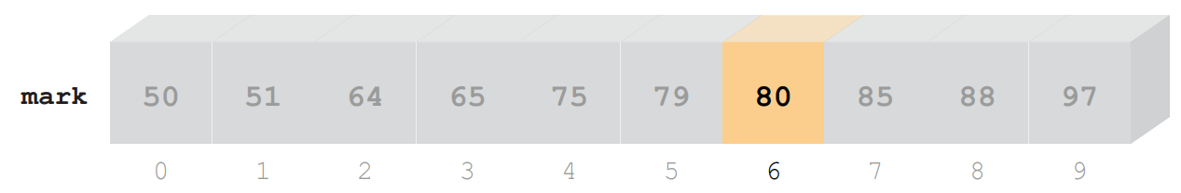
Binary search
B
6. Since the item is smaller than the target value, it means that the target value can only appear in the second half of the search range.

Slide 23
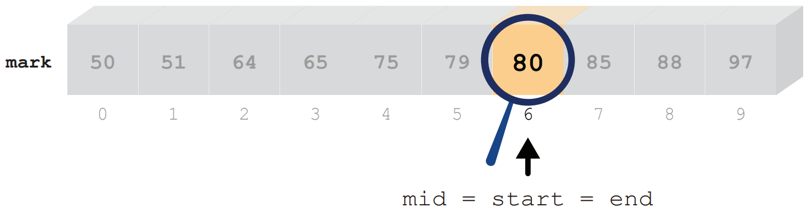
Binary search
B
7. The search is finally narrowed down to just one item. If this item is the same as the target value, the search ends. Otherwise, the target value does not exist in the list.

Slide 24
Binary search
B
A binary search algorithm is written into the following Python program:
start = 0 end = len(mark)-1 target = int(input()) found = False while start <= end and found == False: mid = int((start + end)/2) if mark[mid] == target: found = True else: if target < mark[mid]: end = mid – 1 else: start = mid + 1 if found == True: print("Found at index", mid) else: print("Not found")

Slide 25
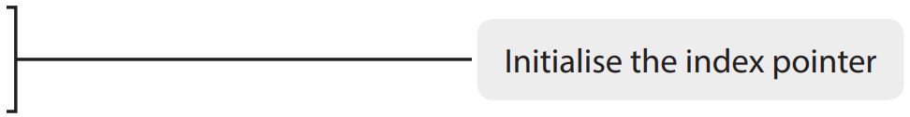
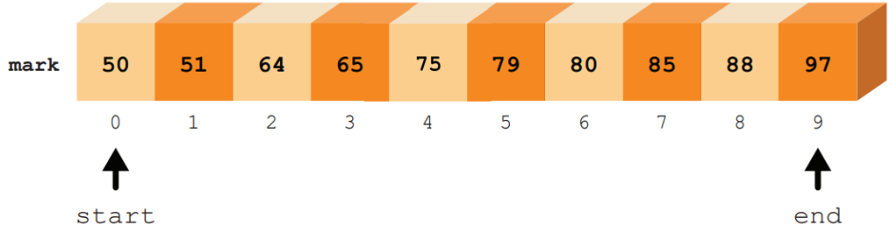
Binary search
B
A binary search algorithm is written into the following Python program:
start = 0 end = len(mark)-1 target = int(input()) found = False while start <= end and found == False: mid = int((start + end)/2) if mark[mid] == target: found = True else: if target < mark[mid]: end = mid – 1 else: start = mid + 1

Slide 26
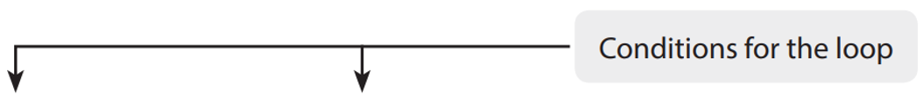


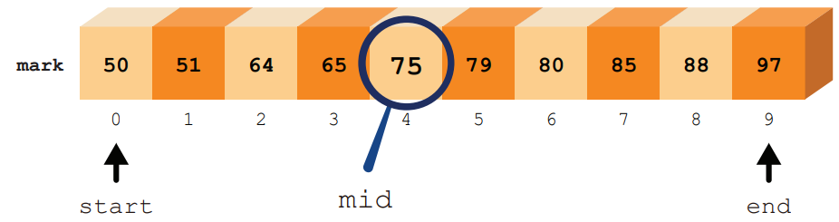
Binary search
B
A binary search algorithm is written into the following Python program:
end = len(mark)-1 target = int(input()) found = False while start <= end and found == False: mid = int((start + end)/2) if mark[mid] == target: found = True else: if target < mark[mid]: end = mid – 1 else: start = mid + 1

Slide 27
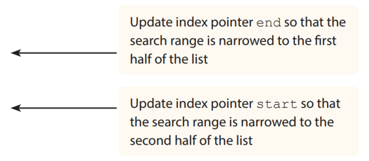
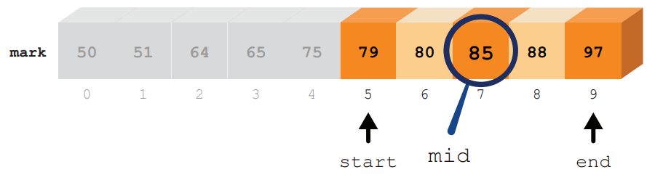
Binary search
B
A binary search algorithm is written into the following Python program: mid = int((start + end)/2) if mark[mid] == target: found = True else: if target < mark[mid]: end = mid – 1 else: start = mid + 1 if found == True: print("Found at index", mid) else:

Slide 28
Binary search
B
Binary search assumes that the items in a list have been sorted and starts searching from the middle of the list.
After each comparison, even if the item is not the same as the target value, the search range can be reduced by half.

Slide 29
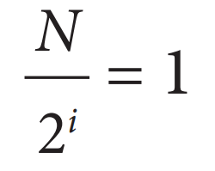
Binary search
B
The worst case is that the target value is stored in the last item in the list or does not exist in it. That is, after the i^{th} iteration, only one item remains in the search range.

Slide 30
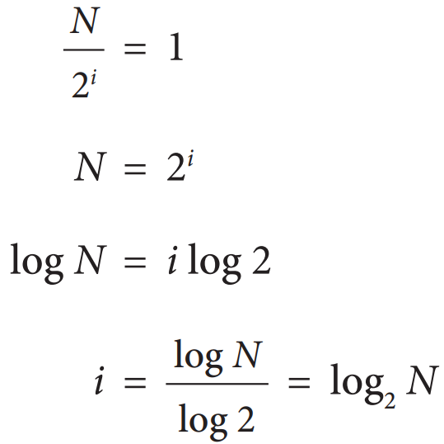
Binary search
B
Using the previous equation, we can calculate the maximum number of iterations required for searching a list with N items in the worst case:

Slide 31
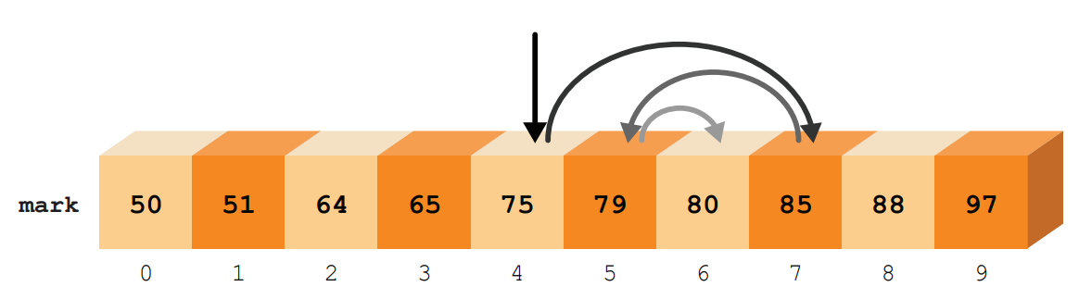
Binary search
B
The maximum number of iterations required for a binary search of the list mark with ten items is 4 (log₂ 10 = 3.32).

Slide 32
6.2
1. The following array age stores the ages of the N customers who have purchased a product, sorted in descending order. The following example shows the first ten array items:

Slide 33
6.2
(a) Mr Chan, the manager, writes the sub-program SearchByBinary(target) which searches for the target value target using binary search. If the target value is found, the sub-program will return the array index where the target value is stored. If the target value is not found, “-1” will be returned instead. Write the pseudocode for SearchByBinary(target).
Sub-program SearchByBinary(target) start ← _____________ end ← _____________ while _____________ do mid ← _____________ if age[mid] = target then return _____________ else if age[mid] > target then _____________ else _____________ return _____________

Slide 34
6.2
(b) Mr Chan writes another sub-program count(target), which returns the number of customers whose age is equal to target.
(i) What is the return value for calling count(38)?
(ii) What is the return value for calling count(29)?
(iii) What is the return value for calling count(18)?
(iv) What is the return value for calling count(25)?

Slide 35
6.2
(c) The following is the pseudocode for count(target):
Sub-program count(target) index ← SearchByBinary(target) if index = -1 then return 0 else left ← leftMost(index) right ← rightMost(index) return (right - left + 1)
The sub-program leftMost(index) returns the index of the first item that stores the value of age[index]; the sub-program rightMost(index) returns the index of the last item that stores the value of age[index].

Slide 36
6.2
(i) What is the return value for calling leftMost(5)?
(ii) What is the return value for calling rightMost(5)?

Slide 37
6.2
(d) The following is the pseudocode for the sub-program rightMost(index).
Sub-program rightMost(index) right ← index while right < N AND age[right+1] = age[index] do right ← right + 1 return right
Write the pseudocode for leftMost(index) by referring to the above algorithm. Sub-program leftMost(index)

Slide 38
6.2
◣ Solution
(a) Sub-program SearchByBinary(target) start ← 1 end ← N while start <= end do mid ← (start + end) // 2 if age[mid] = target then return mid else if age[mid] > target then start ← mid + 1 else end ← mid - 1 return -1

Slide 39
6.2
(b) (i) 3 (ii) 2 (iii) 0 (iv) 1
(c) (i) 4 (ii) 6 (d) Sub-program leftMost(index) left ← index while left > 1 and age[left-1] = age[index] do left ← left – 1 return left

Slide 40
6.2
Complete Checkpoint 6.2 on P. 225.
(a) keywords = ["and", "as", "def", "elif", "else"] start = 0 end = len(keywords)-1 name = input() found = False while start <= end and found == False: mid = int((start + end)/2) if keywords[mid] == name: found = True else: if name[0] < keywords[mid][0]: end = mid – 1 else: start = mid + 1 if found == True: print("This is a keyword.") else: print("Available for use")

Slide 41
6.2
(b) N = 300, log2 N = log2 300 = 8.23 The strings will be compared 9 times.

Slide 42
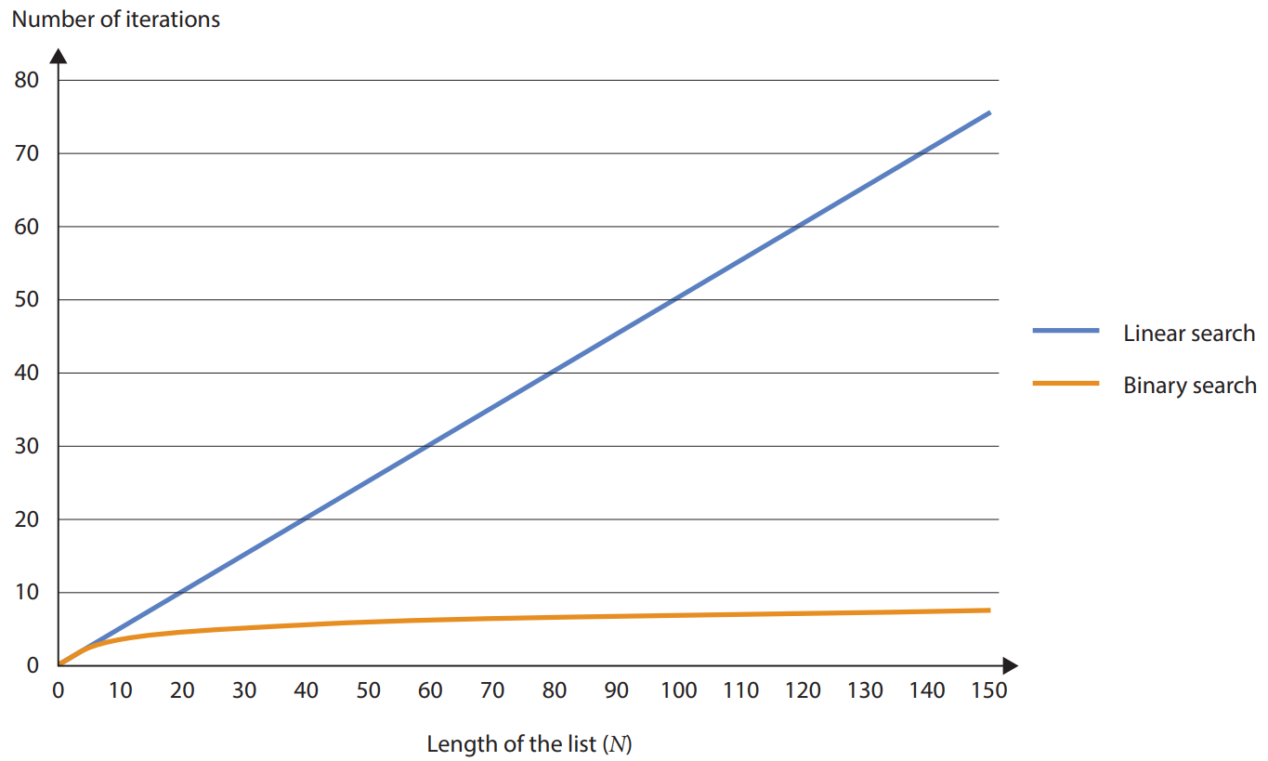
Comparison between linear search and binary search
C
The following chart shows the average numbers of iterations required by the program for using linear search and binary search respectively in lists of different lengths.

Slide 43
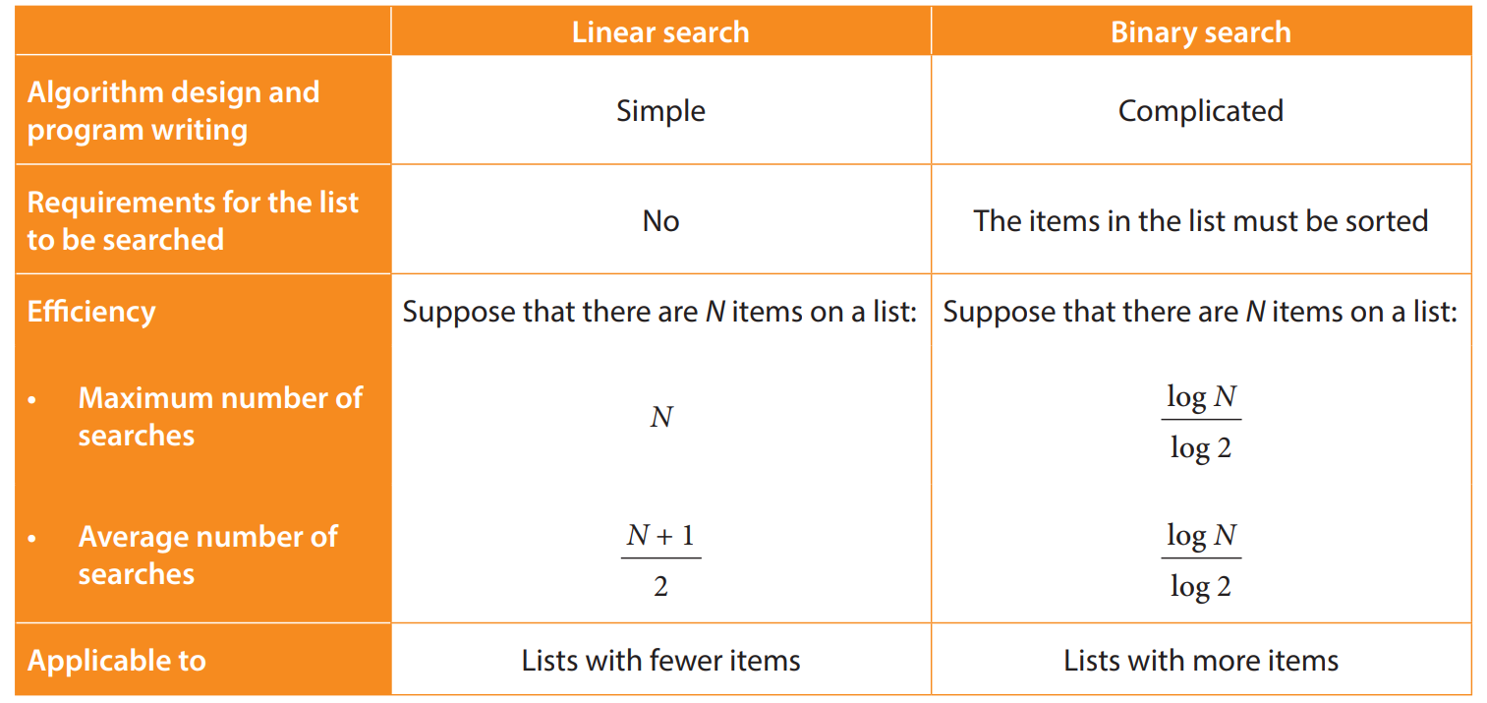
Comparison between linear search and binary search
C
The following table lists the advantages and limitations of linear search and binary search:

Slide 44
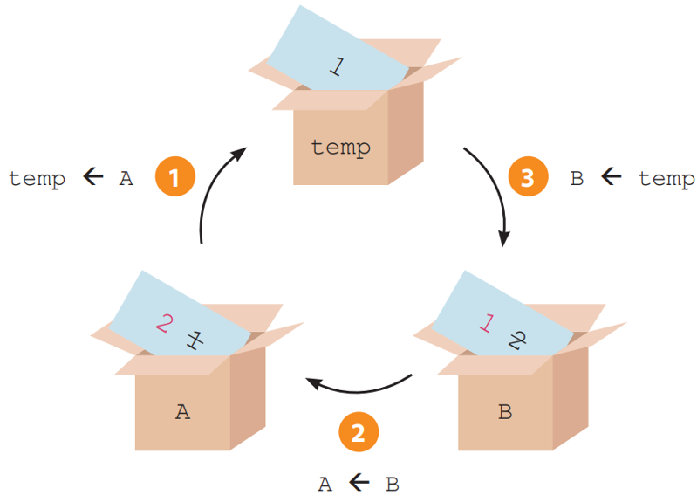
Swapping
6.2
If we need to swap the values of two variables (A and B), we can use the variable “temp” to temporarily store the value of one of the variables, as shown in the example below:
A ← 1 B ← 2 temp ← A A ← B B ← temp

Slide 45
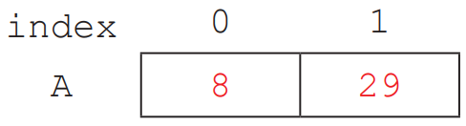
6.3
Complete Checkpoint 6.3 on P. 231 of the textbook.
1 (a)
(b) Sub-program swap(num) temp ← num[0] num[0] ← num[1] num[1] ← temp

Slide 46
6.3
2. (a)
(b) Swapping the values of array items A[m] and A[n].

Slide 47
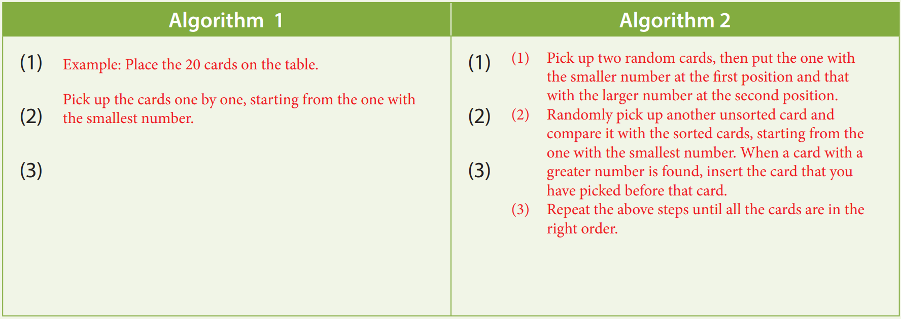
6.3
Complete Activity 6.3 on P. 232 of the textbook.

Slide 48
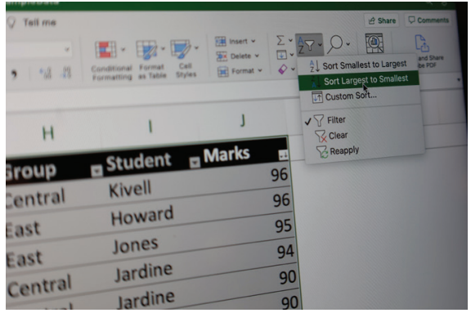
Sorting Algorithms
6.3
As its name suggests, sorting means arranging a series of data in ascending or descending order. We often need to sort data for different purposes.
For example, in a spreadsheet that stores the marks of 100 students, the marks are sorted from highest to lowest.

Slide 49
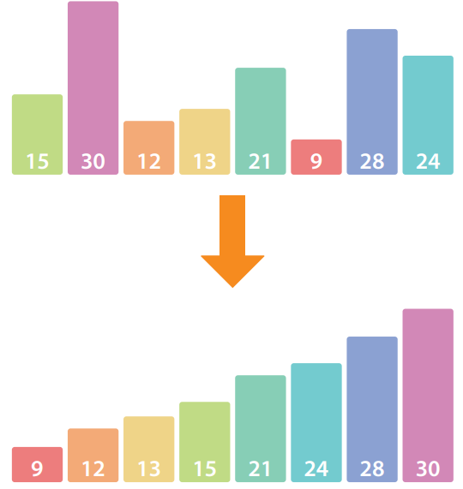
Sorting Algorithms
6.3
Sorting is also relevant to binary search, which we have learnt earlier. Binary search helps us find the target value quickly, but this algorithm is only applicable to sorted lists.

Slide 50
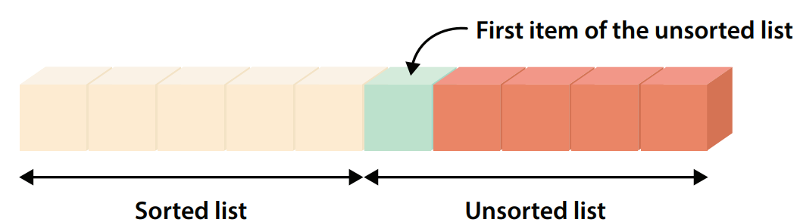
Selection sort
A
Selection sort is based on linear search. The algorithm repeatedly carries out linear search in the unsorted part of the list in order to find the maximum or minimum value.
Then, this value is swapped with the first item of the unsorted list so as to set up the sorted part of the list. This process is repeated until all list items have been sorted.

Slide 51
Selection sort
A
The following Python program uses selection sort to sort list mark in descending order:
for i in range(0, len(mark)): max_index = i for j in range(i+1, len(mark)): if mark[j] > mark[max_index]: max_index = j temp = mark[i] mark[i] = mark[max_index] mark[max_index] = temp

Slide 52
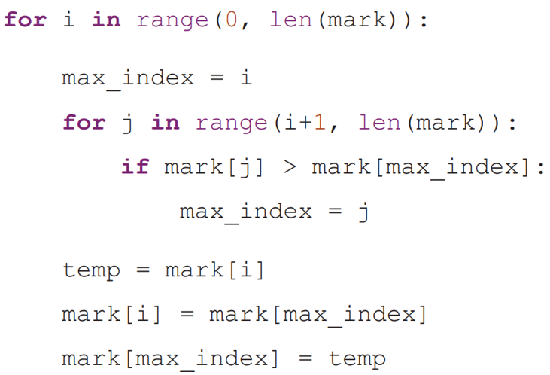
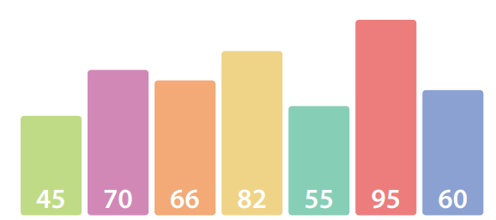
Selection sort
A
1. Firstly, perform linear search on the list to find the maximum value.

Slide 53
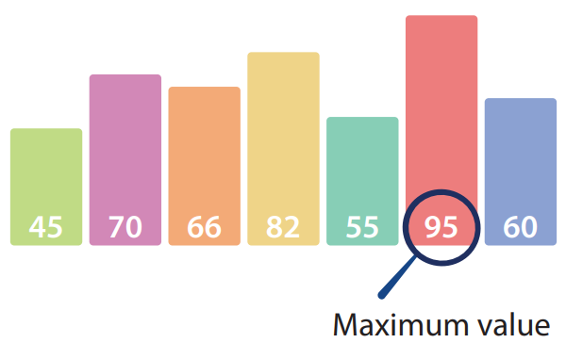
Selection sort
A
1. Firstly, perform linear search on the list to find the maximum value.

Slide 54
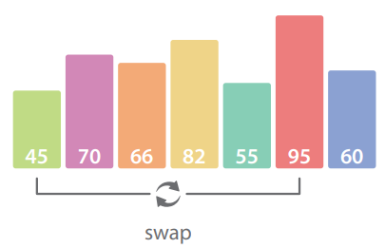
Selection sort
A
2. Swap the maximum value with the first item of the list.

Slide 55
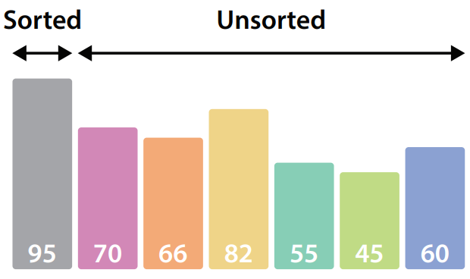
Selection sort
A
This divides the sorted and unsorted parts of the list.

Slide 56
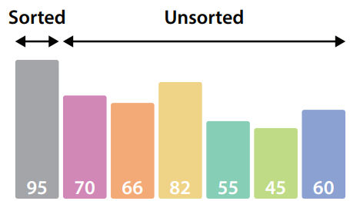
Selection sort
A
3. Then, perform linear search on the unsorted part to find the maximum value.

Slide 57
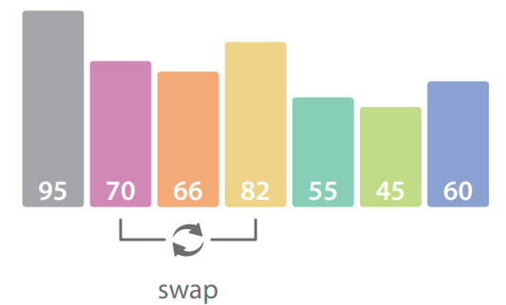
Selection sort
A
4. Swap the maximum value with the first item of the unsorted list.

Slide 58
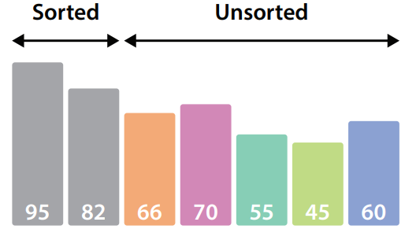
Selection sort
A
This adds an item to the sorted list.

Slide 59
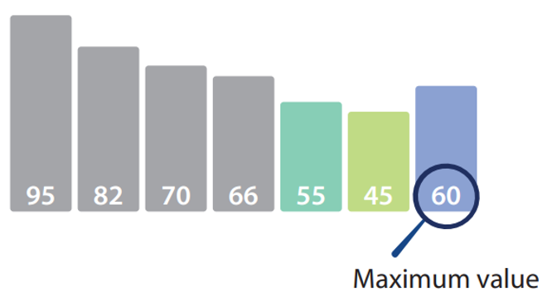
Selection sort
A
5. Repeat the above operations of linear search and swapping.

Slide 60
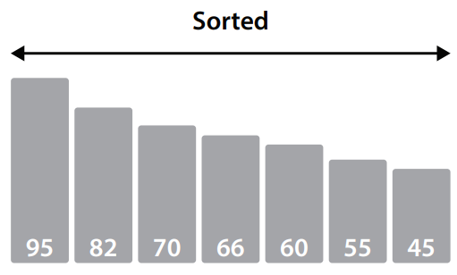
Selection sort
A
6. Repeat until all list items have been sorted.

Slide 61
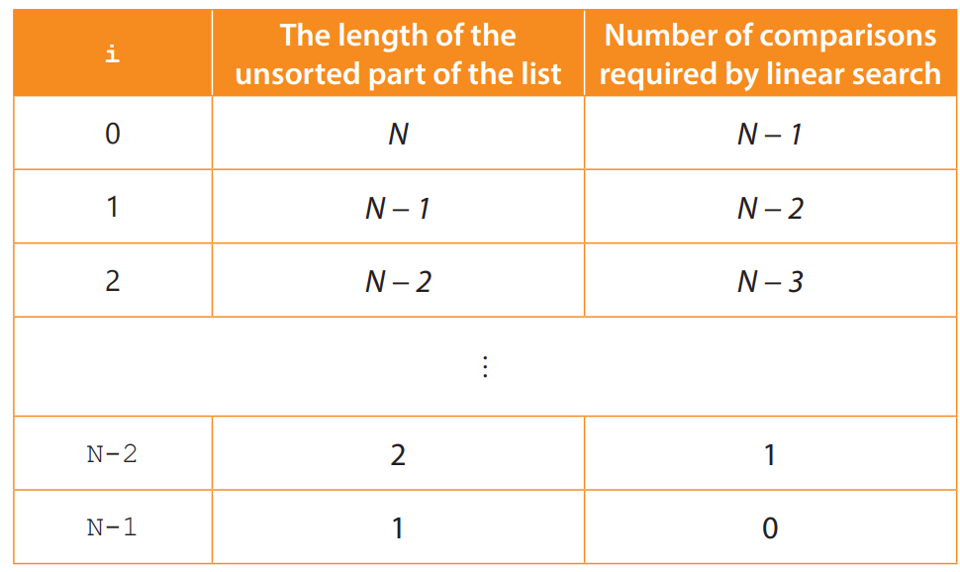
Selection sort
A
Suppose that there are N items in the list:

Slide 62
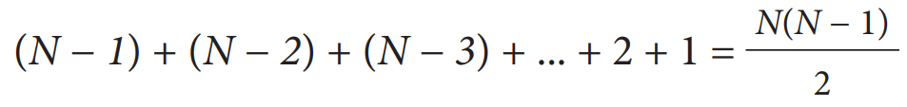
Selection sort
A
Therefore, the number of comparisons for completing the whole selection sort is:
When selection sort is performed on list mark with seven items, the maximum number of comparisons to be performed by the program is 21.

Slide 63
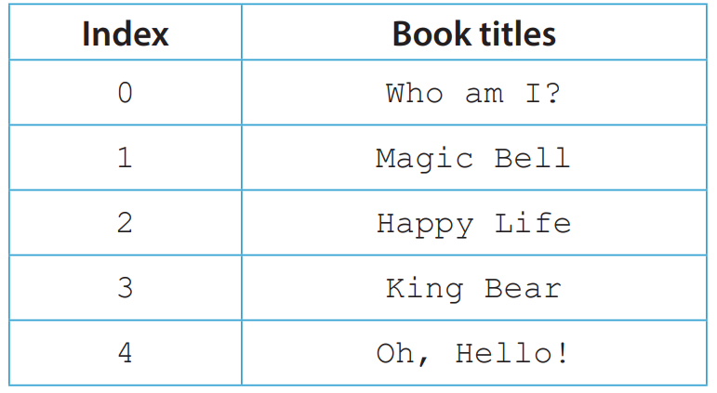

6.3
1. Steven records the titles of five books in array book as follows:
He has written the following algorithm, which uses selection sort to sort the items in array book in ascending order. Suppose that the character “A” is smaller than the character “B”, the character “B” is smaller than the character “C”, and so on.

Slide 64
6.3
Line Pseudocode
1 Sub-program swap(a, b) 2 temp ← book[a] 3 book[a] ← book[b] 4 book[b] ← temp 5 for i from 0 to 4 6 min_index ← I 7 for j from i+1 to 4 8 if book[j] < book[min_index] then 9 min_index ← j 10 Call sub-program swap(______,______)

Slide 65
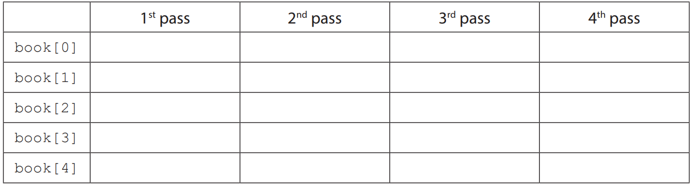
6.3
(a) Complete the pseudocode in line 10.
(b) Write down the content of array book after each pass of line 10.
(c) Suppose that the pseudocode in line 5 is changed to “for i from 0 to 3”. How will this modification affect the result of this sorting algorithm?

Slide 66
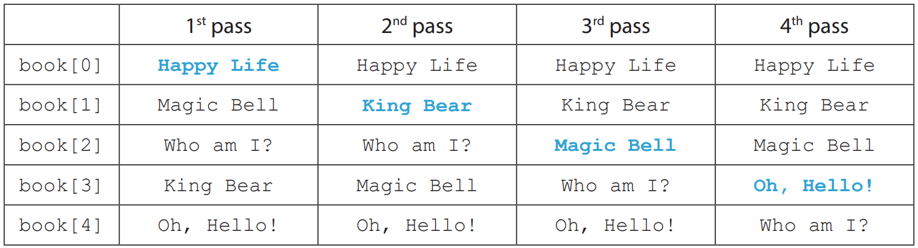
6.3
◣ Solution
(a) Sub-program swap(i, min_index)
(b) The content of array book:
(c) No effect, because the iteration for i = 4 is unnecessary. (When i = 4, only one unsorted item is left, and the part of linear search is skipped in practice. This iteration simply assigns book[4] to temp and puts temp back to book[4].)

Slide 67
6.4
Complete Checkpoint 6.4 on P. 239 of your textbook.
1. (a) Sub-program swap(i, j) temp ← athlete[i] athlete[i] ← athlete[j] athlete[j] ← temp temp ← result[i] result[i] ← result[j] result[j] ← temp

Slide 68
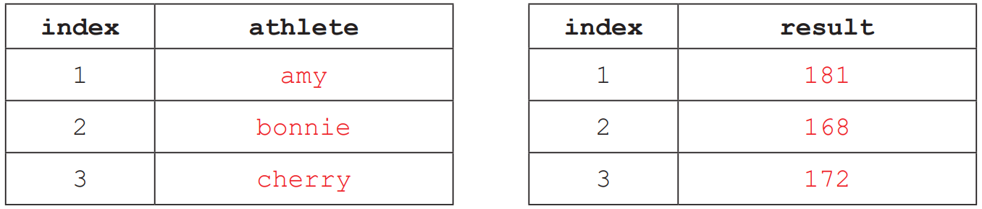
6.4
1. (b) (i)
(ii) Sub-program sortByName for i from 1 to 7 or 8 smallest ← i for j from i+1 to 8 if athlete[j] < athlete[smallest] then smallest ← j Call sub-program swap( i , smallest )

Slide 69
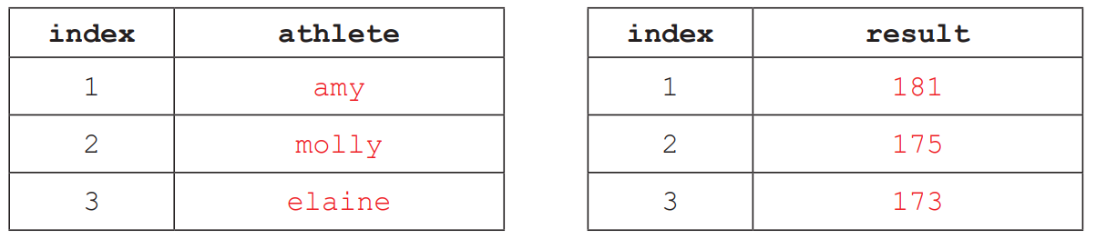
6.4
1. (c) (i)
(ii) Sub-program sortByResult for i from 1 to 7or8 highest ← I for j from i+1 to 8 if result[j] > result[highest] then highest ← j Call sub-program swap( i , highest )

Slide 70
Insertion sort
B
Insertion sort divides the list into the sorted and unsorted parts, then one of the list items in the unsorted part (key value) is inserted into the correct position in the sorted part of the list.
This process is repeated until all list items have been sorted.

Slide 71
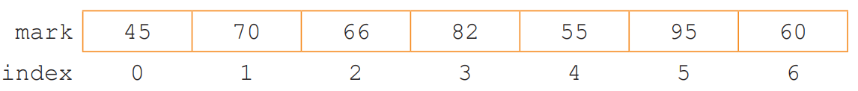
Insertion sort
B
The following list mark stores the exam marks of seven students, as shown below:
Suppose that the list is to be sorted in descending order:

Slide 72
Insertion sort
B
The following Python program uses insertion sort to sort list mark in descending order:
for i in range(1, len(mark)): key = mark[i] j = i-1 while j >= 0 and key > mark[j]: mark[j+1] = mark[j] j = j – 1 mark[j+1] = key

Slide 73
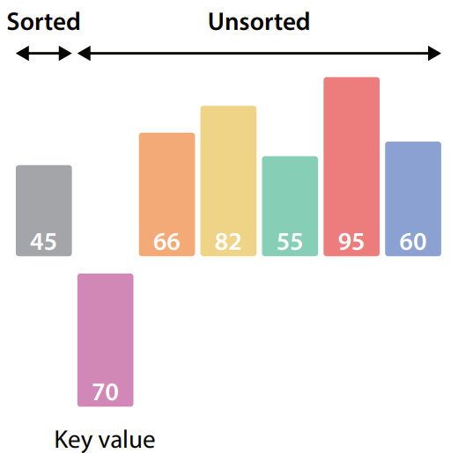
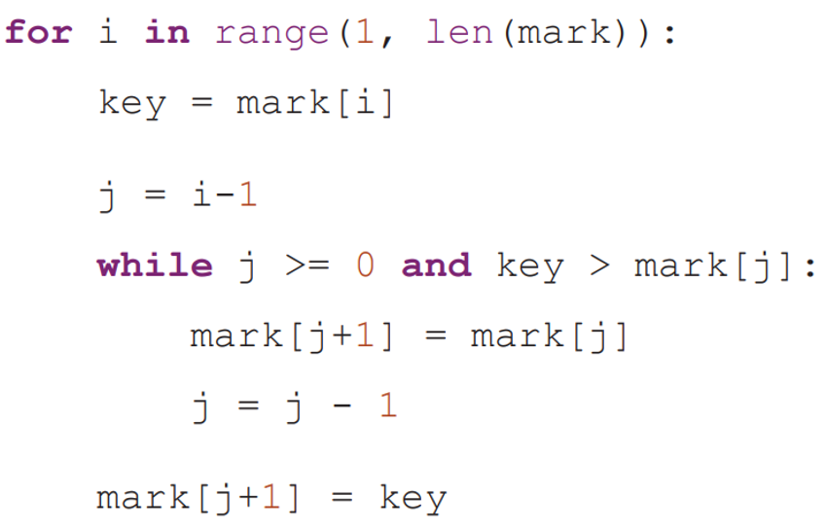
Insertion sort
B
1. Firstly, set apart the first item of the list as the sorted part. Then, take out the first item of the unsorted part (known as “key value”).

Slide 74
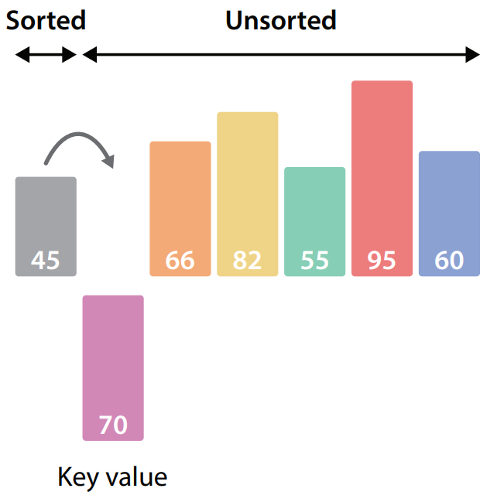
Insertion sort
B
2. To find the correct position for inserting the key value, compare the key value with each list item in the sorted part on the left. If that item is smaller than the key value, move it backwards

Slide 75
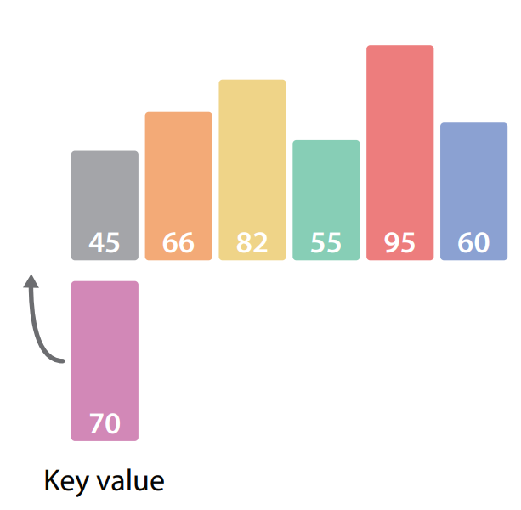
Insertion sort
B
3. Since all the list items in the sorted part have been compared, the key value should eventually be inserted into the first position of the list.

Slide 76

Insertion sort
B
4. Now, an item is added to the sorted section. Similarly, take out the first item of the unsorted part. Compare it with each list item in the sorted part on the left. If that item is smaller than the key value, move it backwards.

Slide 77

Insertion sort
B
5. When a larger item is found, stop moving the items. Here is the position where the key value should be inserted into the list.

Slide 78

Insertion sort
B
6. Repeat the above operations.

Slide 79

Insertion sort
B
7. Repeat until all list items have been sorted.

Slide 80
6.4
Complete Activity 6.4 on P. 244 of the textbook.
1. 0
2. 9

Slide 81
Insertion sort
B
Every time when the loop body of insertion sort is executed:
the best case is the key value is smaller than the item on the left.
the worst case is the key value should be inserted into the first position of the list. If the index of the key value is K, it needs to perform (K – 1) comparisons and swapping.

Slide 82

Insertion sort
B
To conclude, suppose that a list with N items is to be sorted in descending order,
the best case is the list happens to be sorted in descending order
the worst case is the list happens to be sorted in ascending order.
The number of comparisons and swapping for completing the whole insertion sort is:

Slide 83
6.4
1. Brian is writing a price comparison website. He records the price of goods at eight shops in array price as follows:
He has written the following algorithm, which sorts the items in price using insertion sort, as well as a sub-program swap(a, b), which swaps the values of items a and b in array.
Line Pseudocode
1 for i from 1 to 7 2 while i > 0 AND price[i] < price[i-1] 3 swap(price[i], price[i-1]) 4 i ← i - 1

Slide 84
6.4
(a) (i) Write down the content of price after the loop body of i = 1 has been executed.
(ii) Write down the content of price after the loop body of i = 3 has been executed.
(iii) Write down the final content of price after the above algorithm has been executed.

Slide 85
6.4
(b) (i) How many times has line 3 been executed?
(ii) In what situation will line 3 be executed for the least number of times?
(iii) In what situation will line 3 be executed for the greatest number of times?

Slide 86
6.4
(c) Henry writes the following algorithm, which produces the same result as Brian’s algorithm.
Line Pseudocode 1 for i from 0 to 7 2 key ← price[i] 3 j ← i-1 4 while j >= 0 AND key < price[j] 5 price[j+1] ← price[j] 6 j ← j – 1 7 price[j+1] ← key
Which algorithm do you think is more efficient? Explain briefly.

Slide 87
6.4
◣ Solution
(a) (i) The content of price:
(ii) The content of price:
(iii) The content of price:

Slide 88
6.4
(b) (i) 14
(ii) The initial content of price is sorted in ascending order.
(iii) The initial content of price is sorted in descending order.
(c) Henry’s algorithm is more efficient, because the items are moved for fewer times

Slide 89
6.5
Complete Checkpoint 6.5 on P. 248 of the textbook.
1. (a) (i)
(ii)
(iii)
(b) Sort the items in array score in descending order.
(c) 15

Slide 90
Bubble sort
C
Bubble sort starts from the first item of the list and compares an item with its adjacent item. If the two items are in the wrong positions, they will be swapped.

Slide 91

Bubble sort
C
The following list mark stores the exam marks of seven students, as shown below:
Suppose that the list is to be sorted in descending order.

Slide 92
Bubble sort
C
The following Python program writes the algorithm of bubble sort:
for i in range(0, len(mark)-1): for j in range(0, len(mark)-1-i): if mark[j] < mark[j+1]: temp = mark[j] mark[j] = mark[j+1] mark[j+1] = temp

Slide 93


Bubble sort
C
1. Starting from the leftmost item of the list, compare two adjacent list items.

Slide 94
Bubble sort
C
1. If the value on the left is smaller, swap the two items.

Slide 95

Bubble sort
C
2. After the above operation has been completed on the whole list, the smallest value will move (rise) to the last item. This divides the list into the sorted and unsorted parts.

Slide 96

Bubble sort
C
3. Starting from the leftmost item in the unsorted part, compare two adjacent list items.

Slide 97
Bubble sort
C
3. If the value on the left is smaller, swap the two items.

Slide 98

Bubble sort
C
4. After the above operation has been completed once again, the second smallest value will move (rise) to the second last item. This adds one item to the sorted part.

Slide 99

Bubble sort
C
5. Repeat until all list items have been sorted.

Slide 100

Bubble sort
C
Suppose there are N items in the list:

Slide 101

Bubble sort
C
Hence, the number of comparisons required for completing the whole bubble sort is:

Slide 102

6.5
1. Valerie is a judge at a photography competition. She stores the scores of five participants in array A, as shown below:
She has written the following algorithm to process array A:
Line Pseudocode 1 for i from 0 to 3 2 for j from 0 to 3 3 if A[j] > A[j+1] then 4 Swap A[j] and A[j+1]

Slide 103



6.5
(a) (i) Write down the content of A after the loop body of i = 0 has been executed.
(ii) Write down the content of A after the loop body of i = 1 has been executed.
(iii) Write down the content of A after the above algorithm has been executed.

Slide 104
6.5
(b) (i) After the above algorithm has been executed, how many times has the conditional statement in line 3 been executed?
(ii) Vanessa suggests that Valerie should change the pseudocode in line 2 to “for j from 0 to 3-i” in order to enhance the efficiency of this algorithm. Do you agree with Vanessa’s suggestion? Explain briefly.
(c) What is the purpose of this algorithm?

Slide 105
6.5
(d) Valerie only needs to calculate and print the scores of the champion, first runner-up and second runner-up.
(i) After the above algorithm has been executed, which items store the scores of the champion, first runner-up and second runner-up?
Champion: A[_______]
First runner-up: A[_______]
Second runner-up: A[_______]
(ii) How should the pseudocode in line 1 be changed such that the algorithm has the fewest steps of operation?
for i from _______ to _______

Slide 106



6.5
◣ Solution
(a) (i) The content of A:
(ii) The content of A:
(iii) The content of A:

Slide 107
6.5
(b) (i) 6
(ii) Agree. Since the nested loop body is executed for fewer times while the sorting algorithm gives the same result, the algorithm becomes more efficient.
(c) Sorted the items in array A in ascending order.
(d) (i) A[4]
A[3]
A[2]
(ii) for i from 0 to 2

Slide 108
6.6
Complete Checkpoint 6.6 on P. 255 of the textbook.
(a) (i)
(ii)
(iii)

Slide 109
6.6
(b) Sort the dates in array B from earlier to later (or in ascending order).
(c) for j from 8 down to 1+i

Slide 110

Merging Two Sorted Lists
6.4
The following lists class4A and class4B store the exam scores of six and four students respectively, and they have been sorted in ascending order as follows:

Slide 111

The concept of merging lists
A
Suppose that we are going to merge the two lists into list form4, which is sorted in ascending order:

Slide 112
The concept of merging lists
A
The following Python program writes the algorithm for merging lists:
i = 0 j = 0 for k in range(0, len(class4A)+len(class4B)): if i < len(class4A) and (j == len(class4B) or class4A[i] < class4B[j]): form4[k] = class4A[i] i = i + 1 else: form4[k] = class4B[j] j = j + 1

Slide 113


The concept of merging lists
A
1. Compare the first unmerged item of the two lists, and then copy the smaller item to the merged list.

Slide 114

The concept of merging lists
A
2. Repeat the above operations.

Slide 115

The concept of merging lists
A
3. Repeat until all list items have been merged.

Slide 116

6.6
1. Matthew and William are the markers of an examination, which has ten candidates in total. Each of them marks the papers of five candidates, and then stores the marks in descending order in array P and array Q, as shown below:
Matthew writes a sub-program merge. It uses the algorithm for merging lists to merge the marks in array P and array Q, and then store the marks in array score in descending order, i.e. score[0] will store the highest mark.

Slide 117
6.6
(a) After the sub-program merge has been called, what will the content of array score become?

Slide 118
6.6
(b) Complete the pseudocode for the sub-program merge.
Line Pseudocode 1 Sub-program merge 2 i, j, k ← 0 3 for k from 0 to _______ 4 if i = _______ then 5 score[k] ← Q[j] 6 j ← j + 1 7 else if j = _______ then 8 score[k] ← P[i] 9 i ← i + 1 10 else if _______ then 11 score[k] ← P[i] 12 i ← i + 1 13 else 14 score[k] ← Q[j] 15 j ← j + 1

Slide 119
6.6
(c) Simplify lines 4 to 15 in the sub-program merge using a single “if-then-else” conditional statement.
if ________________ then score[k] ← P[i] i ← i + 1 else score[k] ← Q[j] j ← j + 1

Slide 120
6.6
◣ Solution
(a) The content of array score:
(b) 9 5 5 P[i] > Q[j]
(c) i < 5 and (j = 5 or P[i] > Q[j])

Slide 121

6.7
Complete Checkpoint 6.7 on P. 261 of the textbook.
(a)
(b) 14

Slide 122
Other Quicker Sorting Algorithms
6.5
Apart from the above three sorting algorithms, there are faster alternatives, such as merge sort and quick sort.

Slide 123

Efficiency of the Sorting Algorithms
6.6
Comparison of the number of comparisons required by different sorting algorithms

